Slide 1
Objects & Patterns

Slide 2
Introduction -Objects & Patterns
After drawing the interaction diagram, design of class diagrams is drawn.
In practice, the creation of interaction & class diagrams happens in parallel and synergistically.
In UML the two artifacts are represented by UML diagrams become a part of design model.
We have already discussed about interaction diagram, now let us discuss about class diagrams.

Slide 3
Introduction - Objects & Patterns contd…
The UML class diagrams to illustrate classes, interfaces and their associations.
They are used for static object modeling
We have already discussed class diagram while domain modeling.
There we applied class diagram in a conceptual perspective
Here, during design it shifts to software artifacts.

Slide 4
Design Class Diagram(DCD)
A common modeling term for this purpose is Design Class Diagram(DCD)
Here, after identifying the requirements & creating a domain model, the method of object design is carried out by adding methods to the software classes &
Defining messaging between the objects to fulfill the requirements.

Slide 5
Design Class Diagram(DCD) contd…
The creation of design class diagrams is dependent upon the prior creation of:
Interaction diagrams
  Identifies the SW classes that participate in
  the solution, plus the methods of classes.
Conceptual model
  Adds detail to the class definitions.

Slide 6
Design Class Diagram(DCD) contd…
A design class diagram illustrates the specifications for SW classes and interfaces.
Typical information included:
  Classes, associations, and attributes
  Interfaces, with their operations and constants
  Methods
  Attribute type information
  Navigability
  Dependencies

Slide 7
How to make a DCD?
Identify all the classes participating in the SW solution by analyzing the interaction diagrams.
Draw them in a class diagram.
Duplicate the attributes from the associated concepts in the conceptual model.
Add method names by analyzing the interaction diagrams.
Add type information to the attributes and methods.

Slide 8
DCD contd…
Add the associations necessary to support the required attribute visibility.
Add navigability arrows to the associations to indicate the direction of attribute visibility.
Add dependency relationship lines to indicate non-attribute visibility.

Slide 9
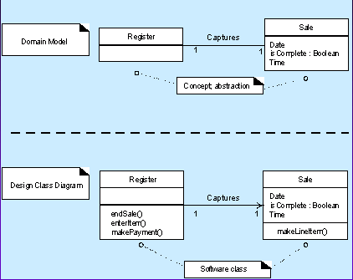
Domain model Vs. DCD

Slide 10
Developing a Domain Class Diagram: the NextGen POS DCD
1) Identify software classes:
Register Sale
ProductCatalog ProductSpecification
Store SalesLineItem
Payment
2) Begin drawing a class diagram
3) Include the attributes from the domain model

Slide 11
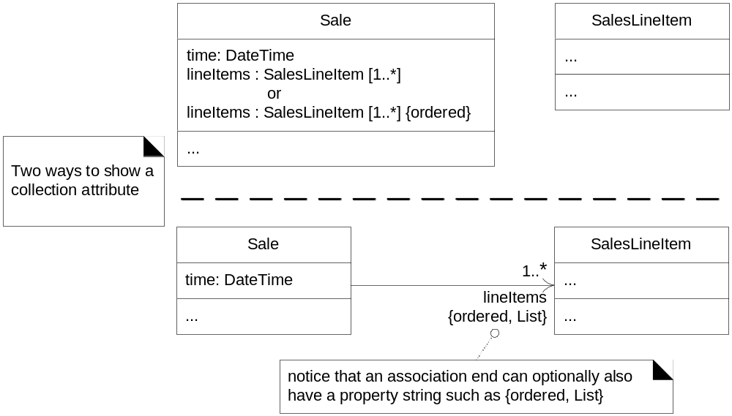
How to show attribute collections?
Figure 16.4

Slide 12
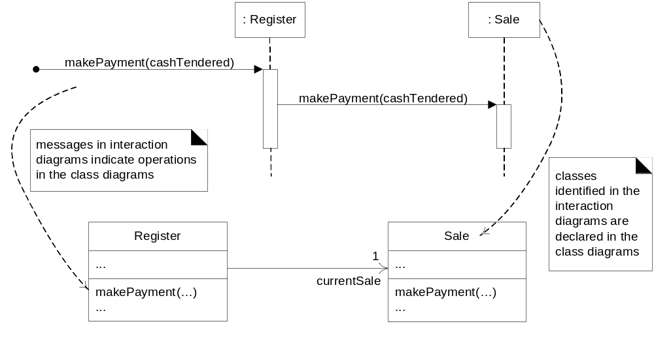
4) Add method names
—from interaction diagrams
—model class & interaction diagrams in parallel

Slide 13
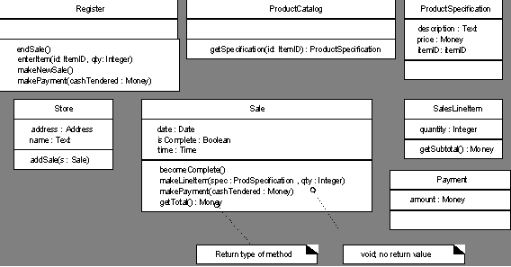
Parameters, return types optional?
—readability vs. code generation

Slide 14
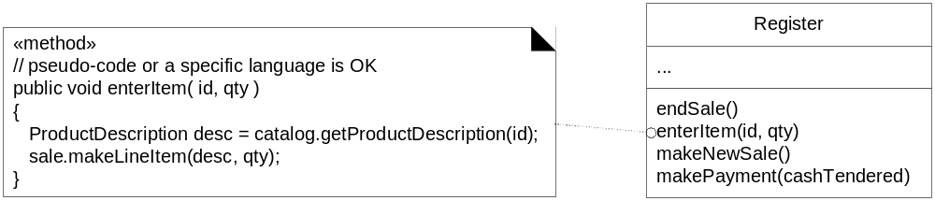
Method body pseudo-code also optional

Slide 15
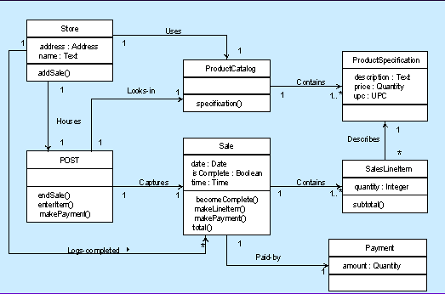
5) Add associations and navigability
—Navigability implies visibility of attributes
What attribute does ProductCatalog implicitly contain?
How does navigability
clarify this design?

Slide 16
6) Adding dependency relationships
Indicates that one element has knowledge of another element
I.e., a change in specification of one thing may affect another thing that uses it, but not necessarily the reverse
A dashed directed line
Typically non-attribute visibility between classes

Slide 17
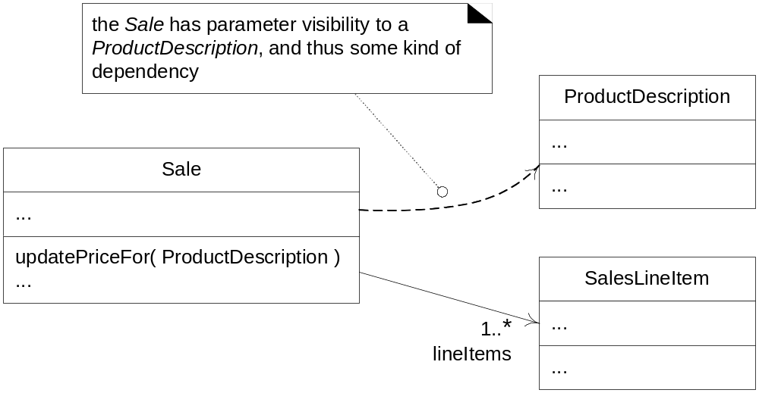
What does dependency add to this DCD?

Slide 18
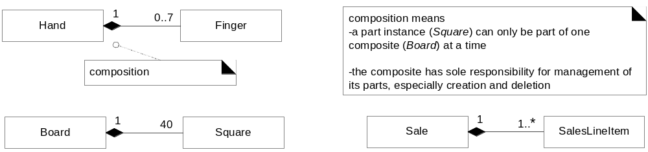
Composition (whole-part) relations

Slide 19
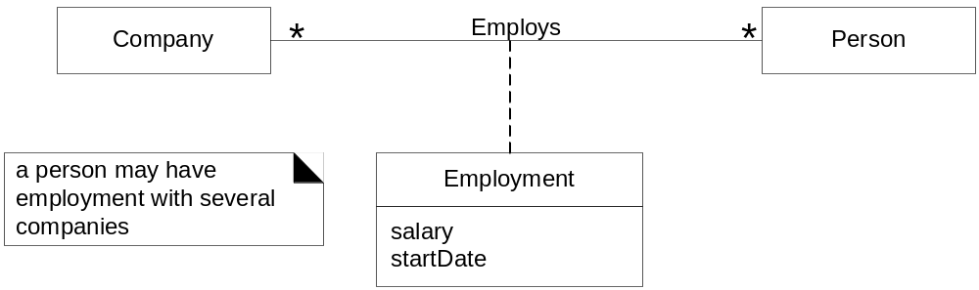
Association classes
—model association with attributes & operations

Slide 20
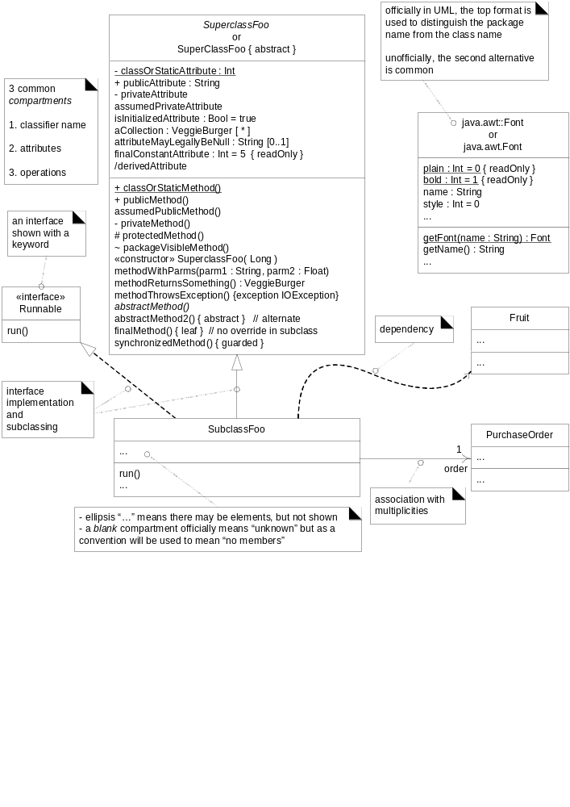
DCD summary

Slide 21
There are deep principles & issues involved in these steps.
Deciding what method belong to where & how object should interact is important.
This is a critical step.
It is possible to introduce the detailed principles & reasoning required to grasp basic object design & to learn to apply these in a methodical approach.
The GRASP patterns are learning aid to help one understand essential object design, &
Apply the design reasoning in a methodical, rational & explainable way
This approach to understanding & using design principles is based on patterns of assigning responsibilities.

Slide 22
UML vs. Design Principles
Since UML is simply a standard visual modeling language,
Knowing its details does not teach you how to think in objects.
The UML is sometimes described as a “design tool” but that’s not quite right.
The critical design tool for software development is a mind , well educated in design principles.
The iterative approach to design involves:
  What can be done? – Prior activities(e.g. workshops) & artifacts
  How do things relate?- influence of prior artifacts(e.g. use cases ) on OOD
  How much design modeling to do, & how?
  What is the output?

Slide 23
Don’t forget to add life in interaction diagram
Remember class name is always noun Exam rather than exam conduction, result rather than result publication.

Slide 24
Responsibilities & responsibility driven design
The popular way of thinking over the design of software objects and also larger scale components is in terms of responsibilities, roles & collaborations.
This approach is called responsibility driven design (RDD)
Here, we think of software objects as having responsibilities – an abstraction of what they do .
The UML defines a responsibility as “a contract or obligation of a classifier
Responsibilities are related to the obligations or behavior of an object in terms of its roles.
These responsibilities are of two types: doing & knowing

Slide 25
Doing responsibilities of an object include:
  Doing something itself such as creating an object or doing calculation
  Interacting action in other objects
  Controlling and coordinating activities in other objects
Knowing responsibilities of an object include:
  Knowing about private calculated data
  Knowing about related objects
  Knowing about things that can derive & calculate.

Slide 26
Responsibilities are assigned to classes of objects during object design.
For example, I may declare that “a sale is responsible for creating SalesLineItems(a doing) or “a sale is responsible for knowing its total” (a knowing)
Relevant responsibilities related to knowing are often inferable from the domain model, because of the attributes & associations it illustrates.
the translation of responsibilities into classes & methods is influenced by the granularity of the responsibility.

Slide 27
Big responsibilities take hundreds of classes & methods.
Little responsibility might take one method.
For example : the responsibility to provide “access to relational databases” may contain hundreds of classes & methods where as
The responsibility to “create a sale” may involve only one method in one class.
A responsibility is not the same thing as a method – it is an abstraction but methods fulfill responsibilities.

Slide 28
RDD also includes collaboration.
Responsibilities are implemented using methods that either act alone or collaborate with other methods & objects.
For example, the Sale class might define one or more methods to know its total; say, a method name getTotal.
To fulfill the responsibility, the sale may collaborate with other objects, such as sending a getSubTotal message to each SalesLineItem object asking for its subtotal

Slide 29
RDD is a Metaphor
RDD is a general responsibility for thinking about OO software design.
Think of software objects similar to people with responsibilities who collaborate with other people to get work done.
RDD leads to viewing an OOD as a community of collaborating responsible objects.

Slide 30
Responsibilities & Interaction Diagrams
Within the UML artifacts, a common context where these responsibilities (implemented as methods) are considered is during the creation of interaction diagrams
Sale objects have been given a responsibility to create Payments, which is invoked with a makePayment message and handled with a corresponding makePayment method.

Slide 31
Interaction diagrams show choices in assigning responsibilities to objects.
When created, decisions in responsibility assignment are made, which are reflected in what messages are sent to different classes of objects.

Slide 32
Responsibilities and Interaction Diagrams
:Register
:Sale
makePayment(cashTendered)
create(cashTendered)
:Payment
Implies Sale objects have a responsibility to create payments

Slide 33
Patterns
Experienced object-oriented developers build up a repertoire(collection) of both general principles and idiomatic solutions that guide them in the creation of software.
These principles and idioms,
  if codified in a structured format describing the problem and solution, and given a name, may be called patterns.

Slide 34
For example:
  Pattern Name: Information Expert
  Problem: What is a basic principle by which to assign responsibilities to objects?
  Solution: Assign a responsibility to the class that has the information needed to fulfill it.

Slide 35
In OOD, a pattern is a named description of a problem & solution that can be applied to new contexts;
ideally a pattern advises us on how to apply its solution in varying circumstances
Many patterns, given a specific category of problem, guide the assignment of responsibilities to objects.

Slide 36
Pattern Have Names
All patterns ideally have suggestive names such as Information Expert.
Why is naming a pattern or principle helpful?
  It supports chunking(grouping) and incorporating that concept into our understanding and memory.
  It facilitates communication. Naming a complex idea such as a pattern is an example of the power of abstraction
  reducing a complex form to a simple one by eliminating detail.
Therefore, the for General Responsibility
Assignment Software Patterns(GRASP) patterns have concise names such as Information Expert, Creator, etc.

Slide 37
GRASP
Name chosen to suggest the importance of grasping fundamental principles to successfully design object-oriented software
Describe fundamental principles of object design and responsibility
Expressed as patterns
the GRASP patterns guide choices in where to assign responsibilities.
Notice, you only grasp fundamentals.
These choices are reflected in interaction diagrams.

Slide 38
Five GRASP patterns:
Creator
Information Expert
Low Coupling
Controller
High Cohesion

Slide 39
Creator pattern
Name: Creator
Problem: Who creates an of A? (doing responsibility)
Solution: Assign class B the responsibility
to create an instance of class A if one of these is true (the more the better):
B contains or aggregates A (in a collection)
B records A
B closely uses A
B has the initializing data for A

Slide 40
Here, in the square creation problem since no classes has been defined yet we should refer to the domain model of it as shown in the figure below.
We see that the board contains squares which is a conceptual perspective, not a software one.
But we can derive from it.
In this example the board creates squares
Also the squares will always be a part of board &
Board manages their creation & destruction.
Thus, they are in a composite aggregation association with a board.

Slide 41
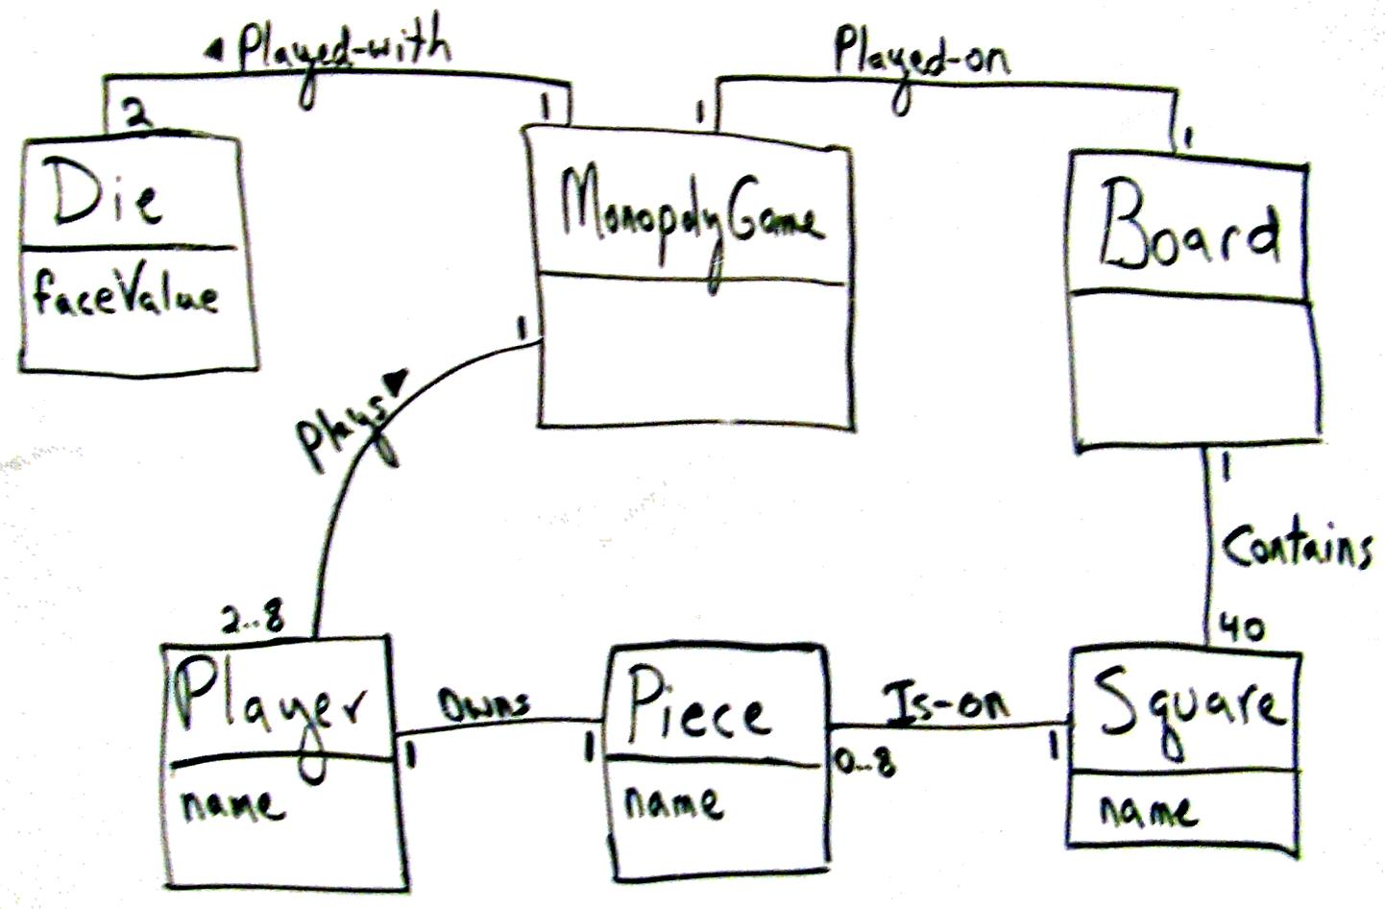
Who creates the Squares?
Figure: Monopoly :iteration 1 domain model

Slide 42
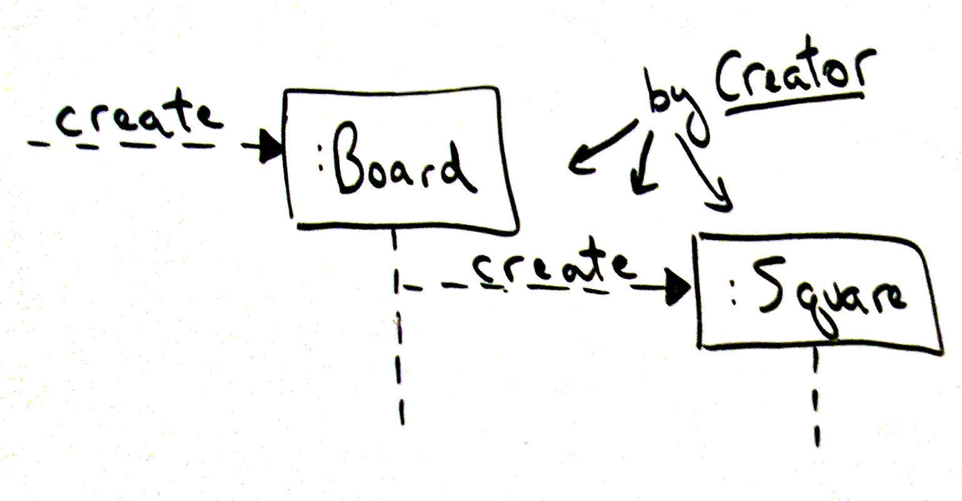
How does Create pattern lead to this partial Sequence diagram?

Slide 43
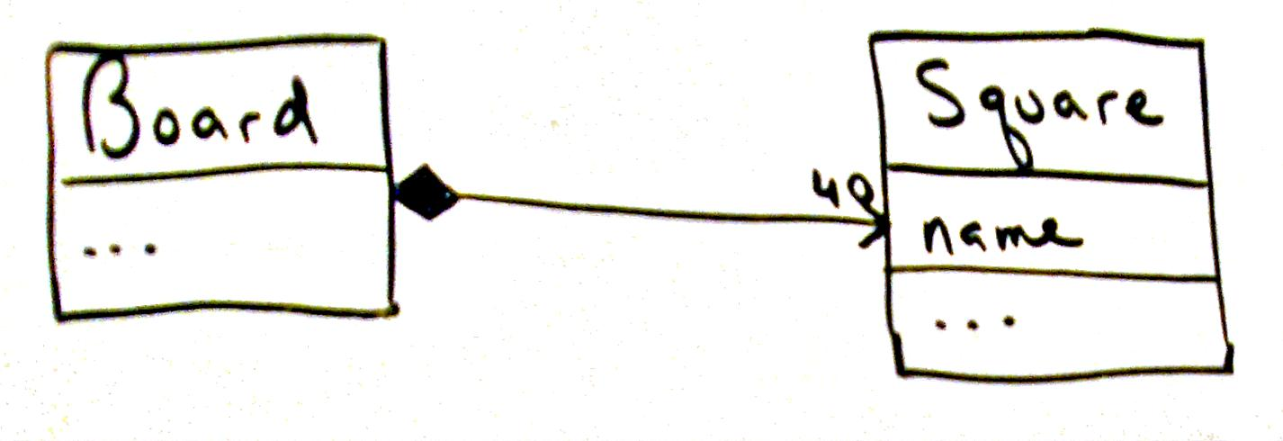
How does Create pattern develop this Design Class Diagram (DCD)?
Board has a composite aggregation relationship with Square
i.e., Board contains a collection of Squares

Slide 44
Discussion of Creator pattern
Responsibilities for object creation are common
Connect an object to its creator when:
  Aggregator aggregates Part
  Container contains Content
  Recorder records
  Initializing data passed in during creation

Slide 45
Information Expert
The pattern Information Expert is the most basic responsibility assignment principles in object design.
Suppose objects need to be able to reference a particular square, given its name.
Who should be responsible for knowing a square, given a key?
This is knowing responsibility but expert also applies to doing.

Slide 46
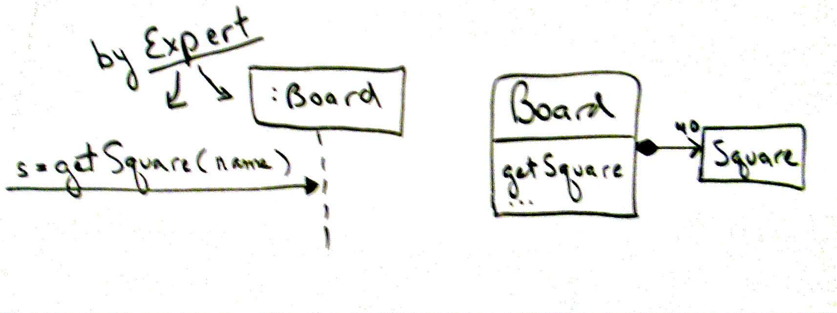
Information Expert pattern or principle
Name: Information Expert
Problem: How to assign responsibilities to objects?
Solution: Assign responsibility to the class that has the information needed to fulfill it?
E.g., Board has the information needed to get a Square

Slide 47
Low Coupling
Expert guides us to assign responsibility to know the particular square, given a unique name, to the Board object because board knows all the squares
It has the information because it is the information expert.
But why expert gives this advice?
Answer is found in the principle of Low coupling.

Slide 48
Coupling is the measure of how strongly one element is connected to, has the knowledge of , or depends on other objects.
If there is a coupling or dependency , when the dependant upon element changes, the dependant may also be affected.

Slide 49
Low Coupling Pattern
Name: Low Coupling
Problem: How to reduce the impact of change and encourage reuse?
Solution: Assign a responsibility so that coupling (linking classes) remains low.

Slide 50
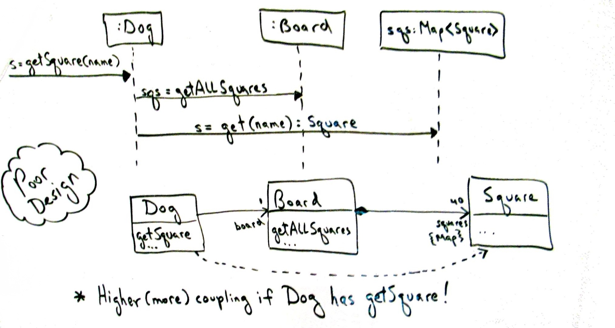
Why does the following design violate Low Coupling?
Why is a better idea to leave
getSquare responsibility in Board?

Slide 51
Benefits
Understandability: Classes are easier
to understand in isolation
Maintainability: Classes aren’t affected by changes in other components
Reusability: easier to grab hold of classes

Slide 52
Controller Pattern
The controller pattern deals with basic question like “ How to connect the UI layer to the application logic layer?
Should the board be first object to receive the play game message from the UI layer?
Or something else? ”
The controller patterns offers the following advice.

Slide 53
Controller pattern
Name: Controller
(see Model-View-Controller architecture)
Problem: Who should be responsible for UI events?
Solution: Assign responsibility for receiving or handling a system event in one of two ways:
  Represent the overall system (facade pattern)
  Represent a use case scenario within which the system event occurs (a session controller)

Slide 54
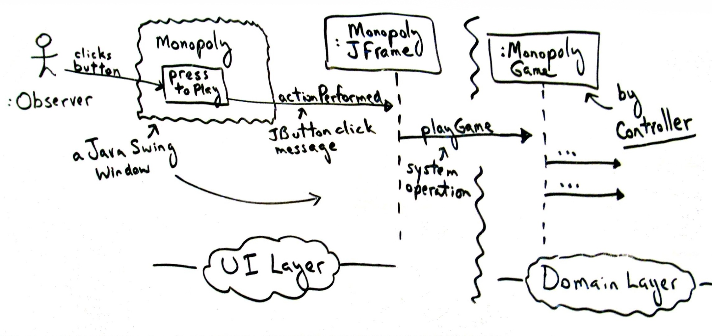
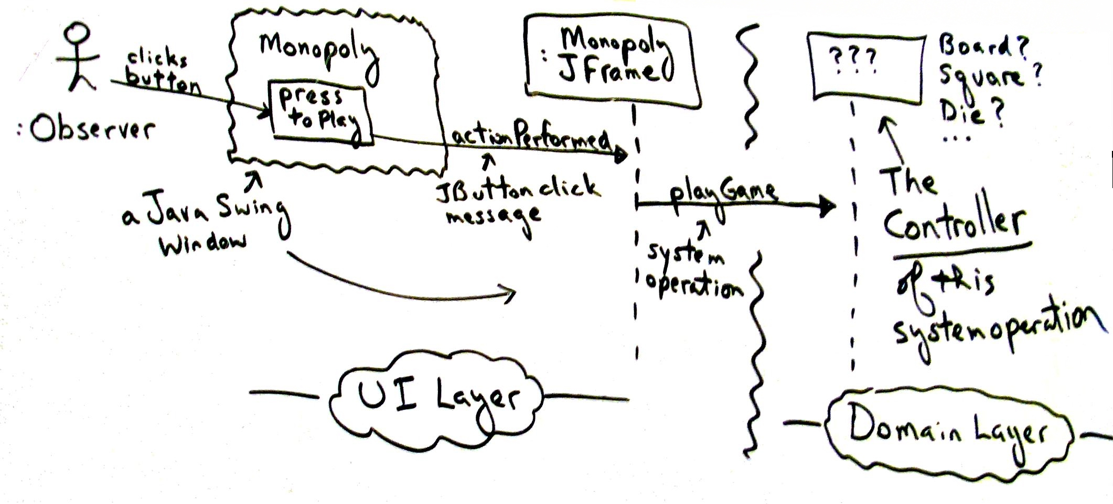
Who is the controller of playGame operation?
What class represents the overall system
or relevant use case scenario?

Slide 55
High Cohesion pattern
Cohesion measures how strongly related and focused are the responsibilities of an element
Name: High Cohesion
Problem: How to keep classes focused and manageable?
Solution: Assign responsibility so that cohesion remains high.

Slide 56
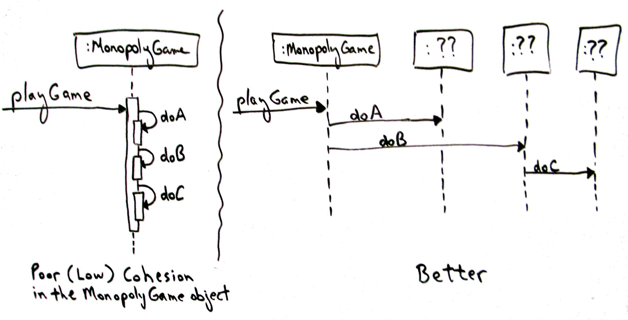
How does the design on right promote high cohesion?
Delegate responsibility & coordinate work

Slide 57
In the left side of the fig object itself does all the work & in the right hand side version delegates & co-ordinates the work with others.
Cohesion informally measures how functionality is related to operations of a software element are &
Also measures how much work software element is doing.

Slide 58
Benefits & Contraindications
Understandability, maintainability
Complements Low Coupling
But:
Avoid grouping of responsibilities or code into one class or component to simplify maintenance by one person. Why?
Sometimes desirable to create less cohesive server objects that provide an interface for many operations, due to performance needs associated with remote objects and remote communication

Slide 59
Applying GRASP to Object Design in the NextGen POS application

Slide 60
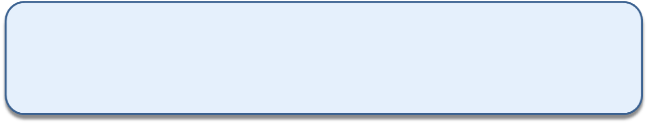
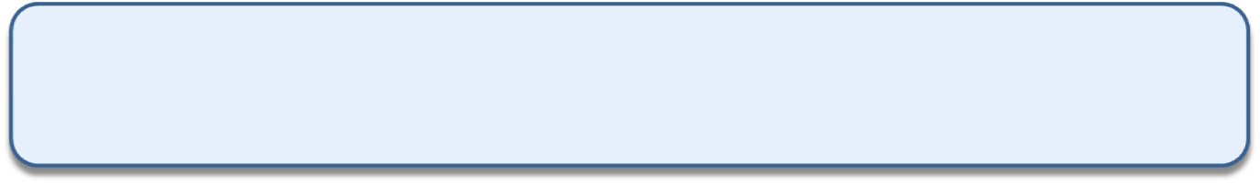
i. Information Expert
Assign a responsibility to the class that has the information necessary to fulfill the responsibility.
Who should be responsible for knowing the grand total of a sale"? (Look up in the design model and the domain model)
Sale
Date
Time
Design Class Responsibility
Sale knows sale total
SaleLineItem knows line item subtotal
Product Specitication knows product price
1
contains
1..*
SaleLineItem
quantity
Product Specitication
price
itemId
* Described-by 1
Only sales instance in conceptual model knows the information about the grand total by having the all the information about the SalesLineItem in the Sale and the sum of their subtotals. Hence sale in information expert

Slide 61
i. Information Expert
Sale
Date
Time
getTotal()
t:= getTotal()
New method
:Sale
SaleLineItem
Quantity
getSubTotal()
New method
t:= getTotal()
:Sale
:salesLineItem
1 *:st:=getSubTotal() → *
Figure : Calculating Sale Total

Slide 62
i. Information Expert
t:= getTotal()
:Sale
:salesLineItem
1 *:st:=getSubTotal() → *
t:= getTotal()
:ProductSpecification
New method
Sale
Date
Time
getTotal()
SaleLineItem
Quantity
getSubTotal()
productSpecification
Price
itemID
getPrice()
Figure : Calculating Sale Total

Slide 63
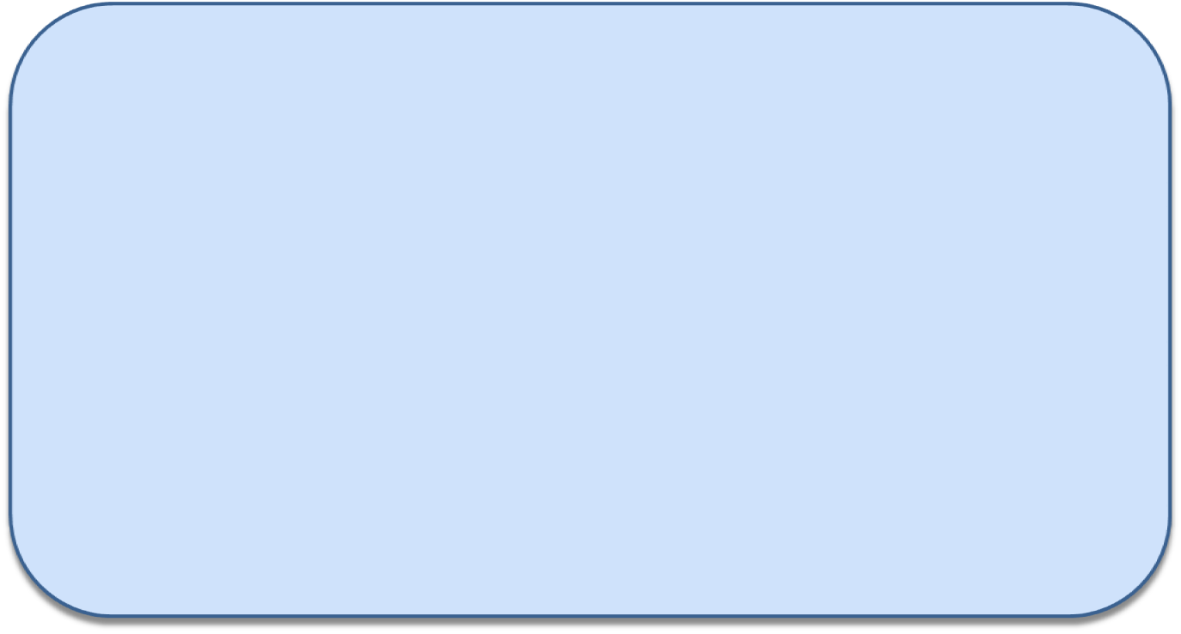
ii. Creator
Assign class B the responsibility to create an instance of class A if one or more of
the following is true:
- B aggregates A objects.
- B contains A objects.
- B records instances of A objects.
- B closely uses A objects.
B has the initializing data that will be passed to A when it is created (thus B is an Expert with respect to creating A).
B is a creator of A objects.
If more than one option applies, prefer a class B which aggregates or contains class A.

Slide 64
ii. Creator
Sale
Date
Time
Aggregates many sale line items!!
1
contains
1..*
SaleLineItem
quantity
Product Specitication
price
itemId
* Described-by 1

Slide 65
ii. Creator
:Register
:Sale
makeLineItem(quantity)
create(quantity)
:SaleLineItem
Implies Sale objects have a responsibility to create payments

Slide 66

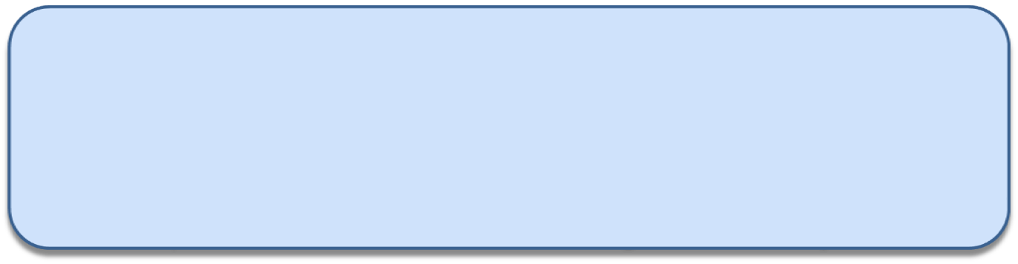
iii. High Cohesion
Assign responsibility so that cohesion remains high
cohesion (or more specifically, functional cohesion) is a measure of how strongly related and focused the responsibilities of an element are.
An element with highly related responsibilities, and which does not do a tremendous amount of work, has high cohesion.
A class with low cohesion does many unrelated things, or does too much work.
Such classes are undesirable; they suffer from the following problems
- hard to comprehend
hard to reuse
hard to maintain
delicate; constantly effected by change
Low cohesion classes often represent a very "large grain" of abstraction, or have
taken on responsibilities that should have been delegated to other objects

Slide 67
iii. High Cohesion
:Register
:Sale
create()
:Payment
addPayment(p)
Makes it incohisive!!
Here the Register is taking on part of the responsibility fulfilling the makePayment function.

Slide 68
iii. High Cohesion
:Register
:Sale
makePayment(cashTendered)
create(cashTendered)
:Payment
Here the Register is taking on part of the responsibility fulfilling the makePayment function.

Slide 69
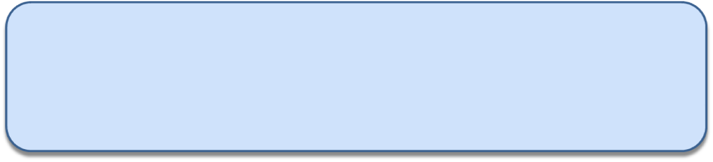
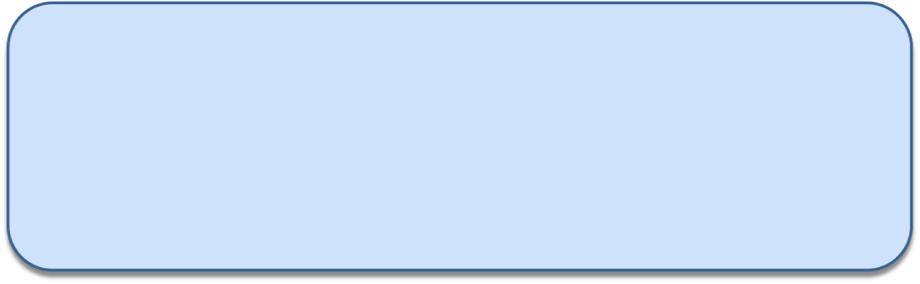
iv. Low Coupling
Assign a responsibility so that the coupling remains low.
Coupling is a measure of how strongly one element is connected to, has knowledge of, or relies on other elements.
An element with low (or weak) coupling is not dependent on too many other elements
A class with low cohesion does many unrelated things, or does too much work.
Such classes are undesirable; they suffer from the following problems:
hard to comprehend
hard to reuse
hard to maintain
delicate; constantly effected by change
Low cohesion classes often represent a very "large grain" of abstraction, or have
taken on responsibilities that should have been delegated to other objects

Slide 70
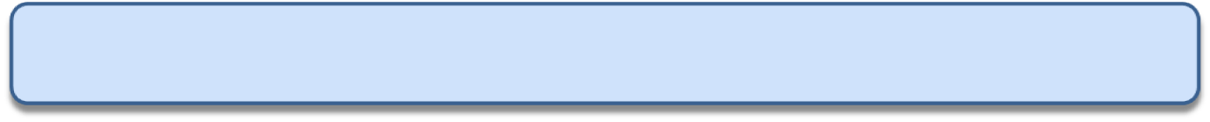
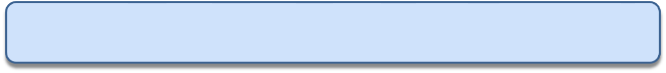
iv. Low Coupling
A need to create a Payment instance and associate it with the Sale.
What class should be responsible for this?
Payment
Register
Sale
Since a Register "records" a Payment in the real-world domain, the Creator pattern suggests Register for creating the Payment.

Slide 71
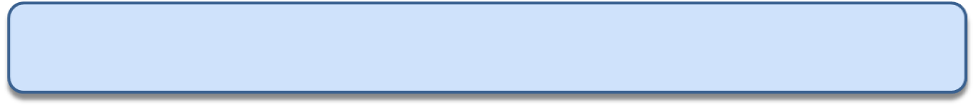
iv. Low Coupling
The Register instance then sends an addPayment message to the Sale, passing along the new Payment as a parameter.
makePayment →
1:create() →
:Register
p: Payment
2: addPayment(p) →
:Sale
makePayment →
1:makePayment →
:Register
:Sale
1.1: create()
Lessens coupling hence better!!
: Payment

Slide 72
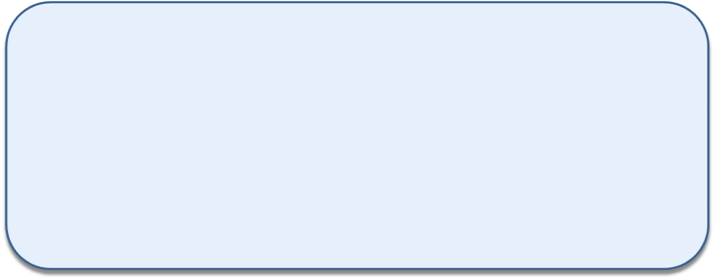
v. Controller
Assign the responsibility for receiving or handling a system event message to a class representing one of the following choices:
Represents the overall system, device, or subsystem (facade controller).
Represents a use case scenario within which the system event occurs, often named <UseCaseName> Handler, <UseCaseName> Coordinator, or <Use-CaseName> Session (use-case or session controller).
System
endSale()
makeNewSale()
namePayment()
enterItem()

Slide 73
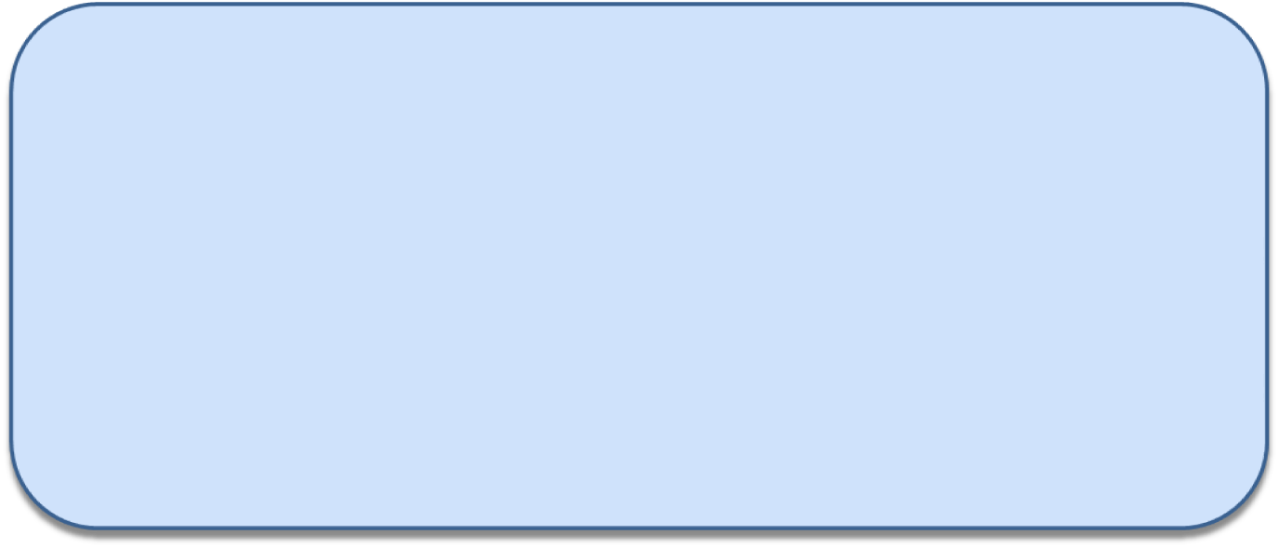
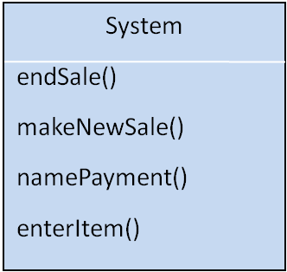
v. Controller
  Use the same controller class for all system events in the same use case scenario.
  Informally, a session is an instance of a conversation with an actor.
Sessions can be of any length, but are often organized in terms of use cases
A Controller is a non-user interface object responsible for receiving or handling a system event.
A Controller defines the method for the system operation.

Slide 74
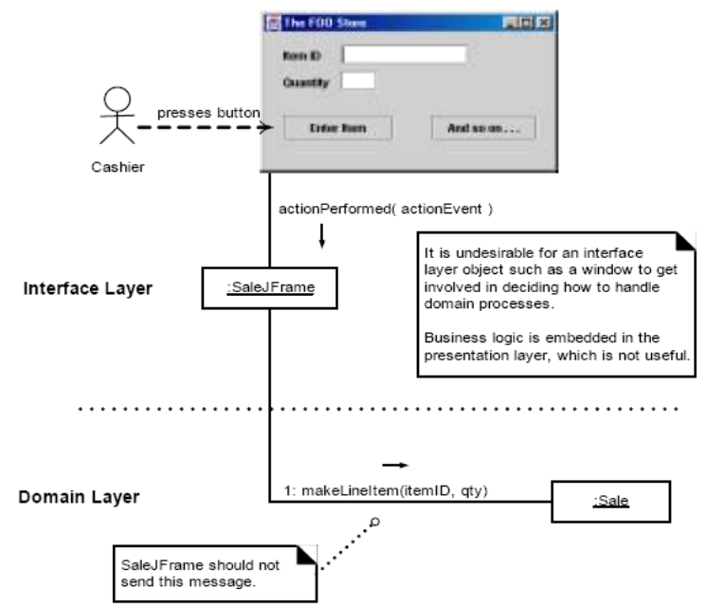
v. Controller

Slide 75
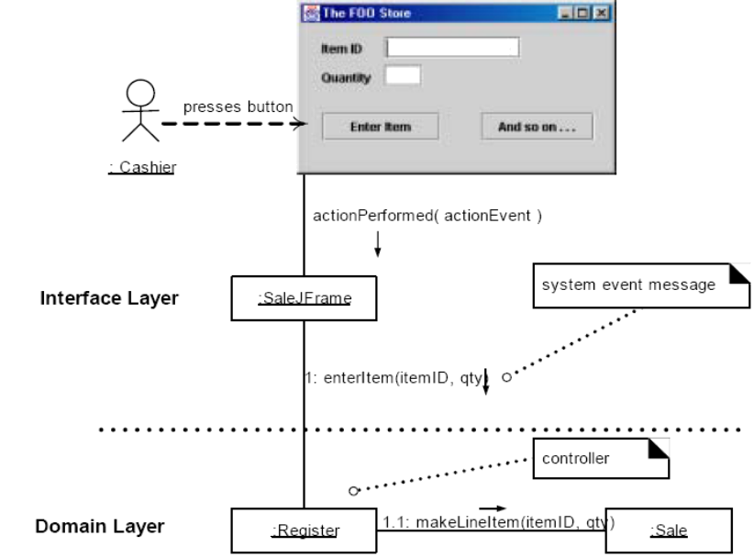
v. Controller

